Slide 1


INTEL ONEAPI HACKATHON
Freshwater Quality Prediction: A Data-Driven Approach

Slide 2
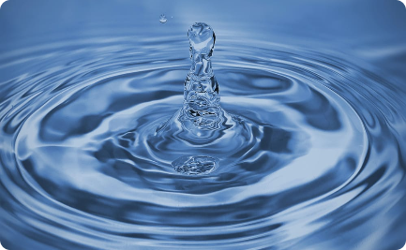
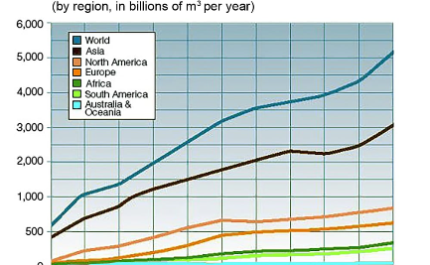

Freshwater Quality Prediction
Scarcity of Freshwater
Provided Dataset
Data Analysis Approach
With only 3% of the earth's water being freshwater, ensuring its quality is crucial for human and ecological well-being.
Explore a comprehensive dataset with 5,956,842 rows and 23 columns to predict the suitability of water for consumption.
Apply advanced techniques to analyze the dataset, identify patterns, and uncover insights into water quality indicators.

Slide 3
Data Cleaning
Missing Values
Feature Selection
By imputing missing values based on feature importance, we preserved the integrity of the dataset.
We dropped irrelevant columns to optimize the prediction of water quality, ensuring accuracy and efficiency.

Slide 4
Model Training
Model Experimentation
F1 Score Comparison
Intel AI Analytics Toolkit
Explore a range of models, including logistic regression, random forest classifier, XGBoost, and DNN, to find the best fit for predicting water quality.
Evaluate the performance of different models based on their F1 score, training time, and accuracy.
Leverage the power of the Intel AI Analytics Toolkit to optimize computations and enhance model efficiency.

Slide 5
Model Evaluation
1
XGBoost
Shortest training time, evaluated based on F1 score and AUC-ROC score.
Random Forest Classifier
2
Highest accuracy achieved, consider practicality for model size.
3
DNN
Good accuracy with lower storage size
Logistic Regression
4
very low time with nominal accuracy

Slide 6

Conclusion
1
Insights into Freshwater Quality
2
Random Forest Classifier
Gain valuable insights into predicting freshwater quality, a fundamental aspect of our daily lives.
Identify the model with the highest accuracy, ensuring reliable predictions for water quality.
3
Training Efficiency
Consider the trade-off between model training time and accuracy, optimizing the prediction process.

Slide 7
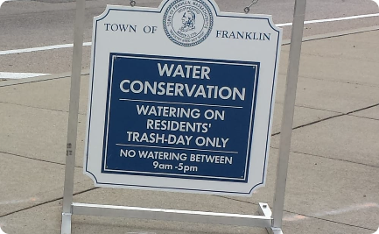
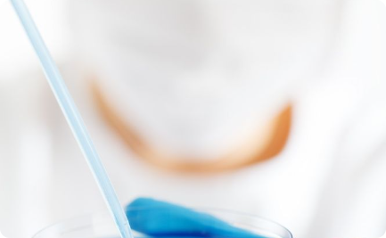
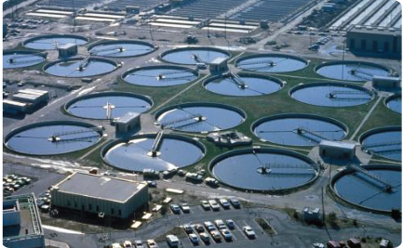
Call to Action
Stay Informed
Be Part of the Solution
Advocate for Change
Learn more about freshwater conservation and its impact on our ecosystems.
Engage in research, innovation, and collaboration to address the global freshwater crisis.
Support policies and initiatives that aim to protect and improve freshwater resources for future generations.

Slide 8

Thank You!
Your participation in this hackathon contributes to the advancement of freshwater quality prediction. Together, we can make a difference!

